Slide 1
XDS.b + Blockchain
Petnathean Julled

Slide 2
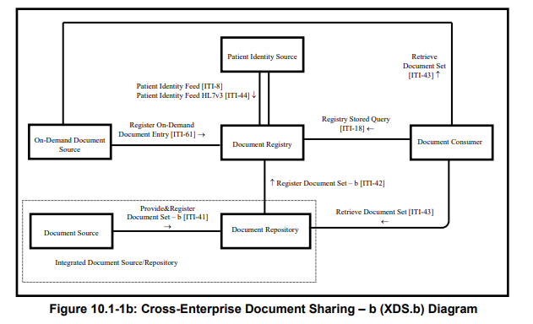
Cross-Enterprise Document Sharing – b (XDS.b)
Notes:
There should be some kind of header that specify type of transaction

Slide 3
Design Analysis Overview
Purpose of Cross-Enterprise Document Sharing (XDS.b) Profile
Digitization of healthcare information drive hospitals to develop their IT infrastructure, however, there came along with emerging cyber-security threats
The Profile facilitates the registration, distribution and access across health enterprises of patient electronic health records.
Cross-Enterprise Document Sharing is focused on providing a standards-based specification for managing the sharing of documents between any healthcare enterprise, ranging from a private physician office to a clinic to an acute care in-patient facility.
* The XDS.b Integration Profile assumes that these enterprises belong to one or more XDS Affinity Domains.
* An XDS Affinity Domain is a group of healthcare enterprises that have agreed to work together using a common set of policies and share a common infrastructure.

Slide 4
Design Analysis Overview
Cross-Enterprise Document Sharing (XDS.b) Profile
Scope or type of sharing document is not restricted by the Profile
Security of XDS Affinity Domain depend on…
Audit Trail and Node Authentication Profile (ATNA)
Each members must have their own Audit Repository Actor
Policies of each XDS Affinity Domain
Trust between each members within XDS Affinity Domain
Confidentiality, Integrity, and Accessibility of Document Registry actor depend on members of XDS Affinity Domain
Benefit gained from Blockchain implemented
By replace traditional database of Document Registry actor with Blockchain ledger, XDS Affinity Domain then lessen required trust between each members. As none of any members can freely temper with anything existing on the Blockchain.
Blockchain ensure integrity of Document Registry. With additional mechanism of Blockchain, it also help reduce risk against confidentiality and accessibility of Document Registry.
Blockchain give additional audit system, as everything published on it cannot be modified or deleted. This is addition to ATNA.
This reduce friction for each healthcare enterprise to joint cooperation and share their data with each other which allow better patient care.

Slide 5
Design Analysis Overview
References
Digital health is a cultural transformation of traditional healthcare
Meskó, Bertalan et al. “Digital health is a cultural transformation of traditional healthcare.” mHealth vol. 3 38. 14 Sep. 2017, doi:10.21037/mhealth.2017.08.07
Digitization of healthcare will increase quality of service and define the meaning of Digital health
The Digitization of the Healthcare Industry
Cisco. The Digitization of the Healthcare Industry: Using Technology to Transform Care. Cisco [Internet]. 2017;1:12. Available from: http://link.springer.com/10.1057/978-1-349-95173-4
Digital Transformation in Healthcare will improve patient experience on healthcare service, driving analytics based on medical data and allow access to new kind of service like telemedicine.
Healthcare records are among the most hacked data in the world. It is estimated that medical information is worth 10 to 20 times more on the black market than credit card data because of its potential for fraud, identity theft, and abuse.
Your medical record is worth more to hackers than your credit card
“Your Medical Record Is Worth More to Hackers than Your Credit Card,” by Caroline Humer and Jim Finkle, Reuters (Sept. 24, 2014).
Cyber criminals are increasingly targeting the healthcare industry, which has many companies still reliant on aging computer systems that do not use the latest security features.
Hospitals have low security, so it’s relatively easy for these hackers to get large amount of personal data for medical fraud

Slide 6
Design Analysis Overview
Related work
Patient journey
Friction

Slide 7
Cross-Enterprise Document Sharing – b (XDS.b)
Notes:
There should be some kind of header that specify type of transaction

Slide 8
Design Analysis Core
Concerned topics
Emerging cyber-threats against healthcare industry
Weakness of centralized database/traditional database
Confidentiality, Integrity, and Availability of database
Interoperability between healthcare organization
Friction against joint cooperation between healthcare enterprise
Need of ‘Trust’ between each party
Blockchain can solve ‘Trust’ problem
Mitigation and business continuity after cyber-incidents
Sharing of document have potential to reduce damage from cyber-incidents and…

Slide 9
Design Analysis Core
Scenario
Group of several hospitals want to share patient information document with each others, then they utilize IHE Cross-Enterprise Document Sharing (XDS) Integration Profile to form XDS Affinity Domain between each other which allow sharing of Document Registry.
Formation of XDS Affinity Domain can be difficult as it require ‘trust’ between each members.
Document registry itself sometimes give potential to exposing patient Protected Health Information or vulnerable to some kind of cyber-attacks. This threaten integrity, confidentiality, and availability of Document Registry itself and those who rely on it for healthcare operations. However, these security issues rely heavily on trust and policies between each members of XDS Affinity Domain.
On the other hand, XDS Affinity Domain may rely on single trusted third party to host Document Registry. This solve ‘trust’ problem but also raise the risk that the centralized database can be the victim instead.
So, we proposing use of Blockchain technology to solve the problem
Attack vector

Slide 10
Design Analysis Core
References
State of Cybersecurity & Cyber threats in healthcare organizations
Le Bris A, Asri W El. STATE OF CYBERSECURITY &amp; CYBER THREATS IN HEALTHCARE ORGANIZATIONS Applied Cybersecurity Strategy for Managers. ESSEC Bus Sch [Internet]. 2017;13. Available from: http://blogs.harvard.edu/cybersecurity/files/2017/01/risks-and-threats-healthcare-strategic-report.pdf
The stakes and risks associated to the healthcare environment will be presented.
Example of attack scenarios
The current state of cybersecurity in healthcare facilities will be portrayed and possible measures to enhance it will be discussed.

Slide 11
Design Analysis Core
Replacing Document Registry’s traditional database with Blockchain
Convert from centralized database to Decentralized ledger
Eliminate need of trusted 3rd party to host Document Registry
Lessen required trust between member of XDS Affinity Domain
Passively enforce agreed policies within Blockchain
How to
XDS Affinity Domain need machine that have access to Ethereum Node
All Ethereum Node from each member of XDS Affinity Domain have access to the same Blockchain ledger that act as Document Registry actor
Replace related transaction that would be need to communicate with normal Document Registry with Smartcontract.
Smartcontract also need to provide additional function that give more capability to what Document Registry can do.

Slide 12
Design Analysis Core
Relate work
A Blockchain-Based Approach to Health Information Exchange Networks
Peterson K, Deeduvanu R, Kanjamala P, Boles K. A Blockchain-Based Approach to Health Information Exchange Networks. Mayo Clin [Internet]. 2016;10. Available from: http://www.colleaga.org/sites/default/files/12-55-blockchain-based-approach-final.pdf
Blockchain that allow healthcare information sharing and audit trail using FHIR URL as main component
A Case Study for Blockchain in Healthcare: “MedRec” prototype for electronic health records and medical research data
Ekblaw A, Azaria A, Halamka JD, Lippman A, Original I, Vieira T. A Case Study for Blockchain in Healthcare: " MedRec " prototype for electronic health records and medical research data. IEEE Technol Soc Mag [Internet]. 2016;1–13. Available from: https://www.healthit.gov/sites/default/files/5-56-onc_blockchainchallenge_mitwhitepaper.pdf
Blockchain that allow healthcare information sharing, patient consent over their own data, and enable Protected Health Information for data analytical research
The Blockchain rely on complex cryptographic key exchange scheme
Decentralizing privacy: Using Blockchain to Protect Personal Data
Zyskind G, Nathan O, Pentland AS. Decentralizing privacy: Using Blockchain to Protect Personal Data. Proc - 2015 IEEE Secur Priv Work SPW 2015. 2015;180–4.
The base work for MedRec
Proposing Cryptographic key scheme that allow Blockchain to track health information sharing between healthcare institutions while allow patient to have control over their own data
Blockchain-Based Data Preservation System for Medical Data
Li H, Zhu L, Shen M, Gao F, Tao X, Liu S. Blockchain-Based Data Preservation System for Medical Data. J Med Syst. Journal of Medical Systems; 2018;42:1–13.
Regardless of what medical data are being published to Blockchain, this work offer Blockchain platform that help encrypt and ensure integrity of the data.

Slide 13
Cross-Enterprise Document Sharing – b (XDS.b)
Notes:
There should be some kind of header that specify type of transaction

Slide 14
Design Analysis Component – XML message compatibility
Replacing Document Registry as receiver of transaction Register Document Set-b [ITI-42]
Existing
Document Repository actor send metadata of document to Document Registry actor with Register Document Set-b [ITI-42] transaction format via TCP
Requirement:
Receive XML message via TCP
Parse XML message and convert it into programming object
Response to Document Repository with message format followed ITI-42
How to
Add TCP socket message receiver function
Add XML parser function
Add constructor for ITI-42 message response following format specified in IHE XDS.b Profile
Add XML message builder function
Behind the design
Common use of XML format transactions in IHE XDS.b Profile
Compatibility with existing XDS Document Repository actor of XDS Affinity Domain members

Slide 15
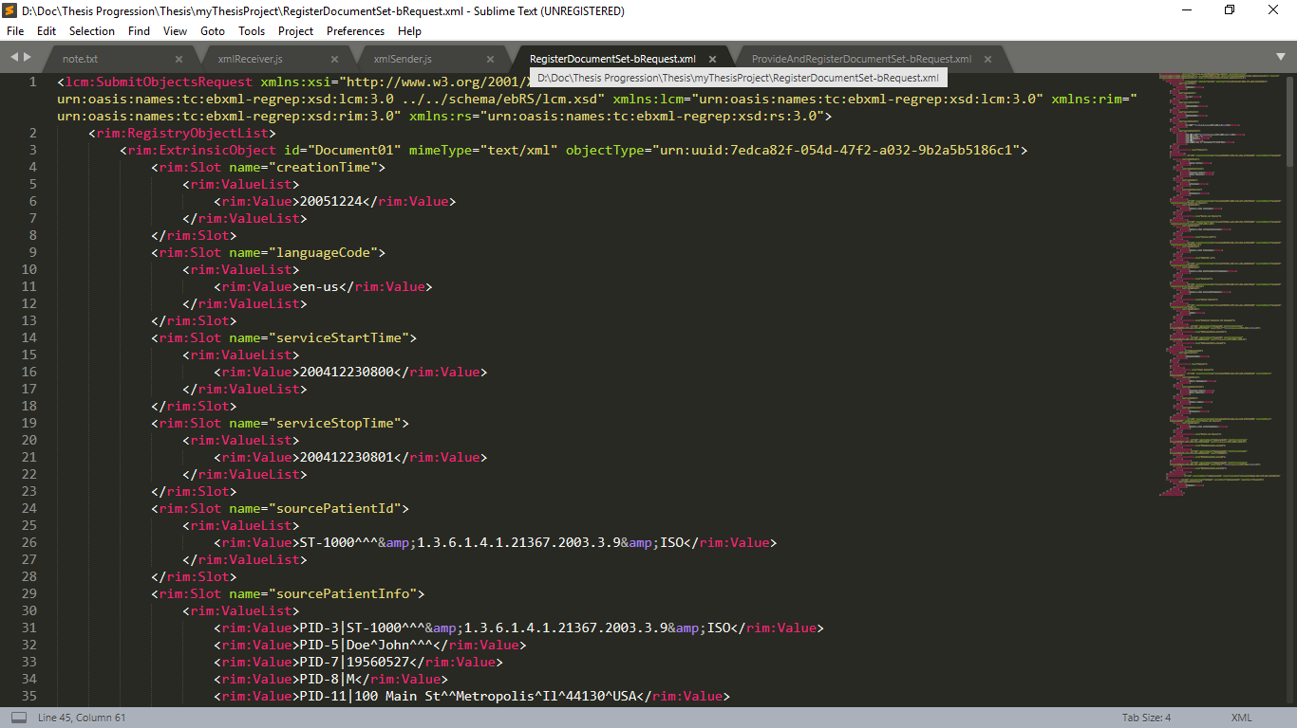
Transaction General XML Format
Header
Metadata Attributes

Slide 16
Transaction type
Notes:
There should be some kind of header that specify type of transaction

Slide 17
Transaction Provide & Register Document Set-b [ITI-41]
Provide and register Document and its metadata to Document Repository.
Document Repository expected actions
Validate and update select received metadata, as detailed below.
Make any received documents available for retrieval via the Retrieve Document Set [ITI-43] transaction.
Convey the updated metadata to the Document Registry via a Register Document Set-b [ITI-42] request.
Issue a Provide and Register Document Set-b [ITI-41] response.

Slide 18
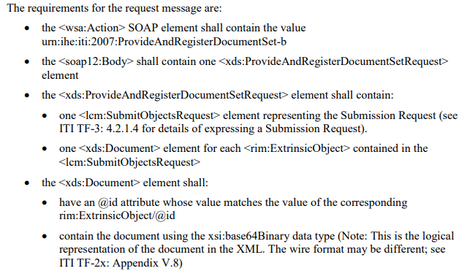
Transaction Provide & Register Document Set-b [ITI-41]

Slide 19
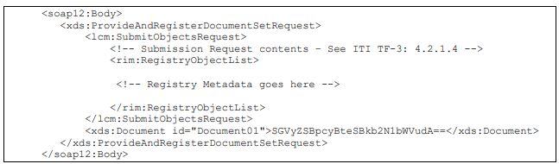
Transaction Provide & Register Document Set-b [ITI-41]

Slide 20
Transaction type
Notes:
There should be some kind of header that specify type of transaction

Slide 21
Transaction Register Document Set-b [ITI-42]
Register document metadata to Document Registry. Metadata enables the receiver to process the content of the message programmatically, without needing to understand the format or contents of the documents.
Document Registry expected actions
Perform metadata validations
Store all IHE-defined metadata attributes received so that it is available to return in responses to future queries.
Return a response message giving the status of the operation.
*If the Document Registry rejects the metadata, it shall:
Return an error including at least one error message in the response.
Roll back any changes made.

Slide 22
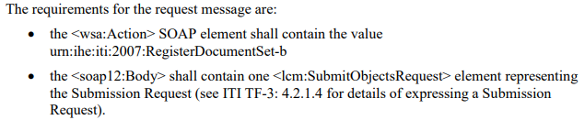
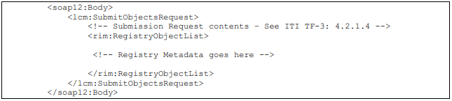
Transaction Register Document Set-b [ITI-42]

Slide 23
Transaction type
Notes:
There should be some kind of header that specify type of transaction

Slide 24
Transaction Registry Stored Query [ITI-18]
This is a query request to the Document Registry from a Document Consumer. The query request contains:
A reference to a pre-defined query stored on the Document Registry Actor.
The Registry Stored Query transaction supports a variety of pre-defined queries. Examples include the following:
Query for DocumentEntry objects by patient (Id) for a time interval on creation time and/or service time, by document type(s), by practice setting(s), by author person
Query for SubmissionSets by Document Source
Query for Folders updated during a time interval
Query for all contents in a Folder or SubmissionSet
Query for SubmissionSets by time of submission
Depending on the value of the returnType parameter, all queries return:
Metadata for one or more types of registry object, or
Object references for one or more types of registry object

Slide 25
Transaction type
Notes:
There should be some kind of header that specify type of transaction

Slide 26
Transaction Retrieve Document Set [ITI-43]
Retrieve a set of documents from the Document Repository, On-Demand Document Source.
The Document Consumer has already obtained the XDSDocumentEntry uniqueId and the Document Repository repositoryUniqueId from the Document Registry by means of the Registry Stored Query transaction.

Slide 27
Transaction Retrieve Document Set [ITI-43]
Document Repository expected actions:
A Document Repository or On-Demand Document Source shall return the document(s) indicated in the request.
The Document Repository shall return the document or an error code in case the document could not be return.
An On-Demand Document Source which supports the Persistence of Retrieved Documents Option shall save the document content returned in the retrieve response and issue a Register Document Set-b [ITI-42] transaction to register a Stable Document Entry which describes the saved document. The On-Demand Document Source shall complete the registration of the Stable Document Entry prior to responding to the Retrieve Document Set request.

Slide 28
Transaction Retrieve Document Set [ITI-43]
The registration of the new Stable Document Entry shall include:
A Submission Set
A DocumentEntry representing the Stable DocumentEntry.
A HasMember association linking DocumentEntry to SubmissionSet.
An IsSnapshotOf Association which identifies the sourceObject as the new Stable Document Entry and the targetObject as the On-Demand Document Entry which contains the uniqueID used in the Retrieve Document Set request.

Slide 29
Metadata used in Document Sharing Profile
The metadata used in Document Sharing profiles is characterized by three types of objects and two types of Associations
Three object types:
SubmissionSet = metadata describing a collection of Folders, DocumentEntries, and Associations submitted together
Folder = metadata describing a collection of related DocumentEntries
DocumentEntry = metadata describing a Document
Two Association types:
HasMember = represents membership of an object in a collection
Relationship = represents a relationship (such as a transform) between two Documents (represented by DocumentEntries)

Slide 30
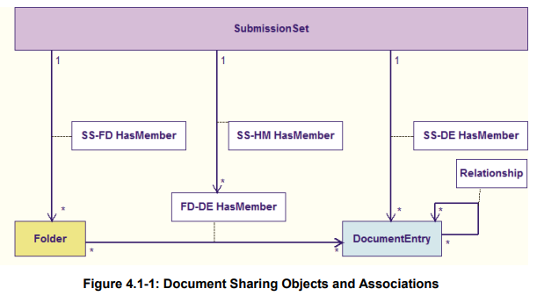
Metadata used in Document Sharing Profile

Slide 31
Metadata used in Document Sharing Profile Code
Document Sharing Object/Association | ebRIM class
DocumentEntry | rim:ExtrinsicObject
SubmissionSet | rim:RegistryPackage
Folder
MemberOf | rim:Association
Relationship

Slide 32
Metadata used in Document Sharing Profile DocumentEntry
DocumentEntry Metadata Attributes | Description | Patient identity | Provenance | Security &Privacy | Descriptive | Object Lifecycle | Exchange
author | The humans and/or machines that authored the document. This attribute contains the sub-attributes: authorInstitution, authorPerson, authorRole, authorSpecialty and authorTelecommunication. |  | ✓ | ✓ | ✓ |  | ✓
availabilityStatus | The lifecycle status of the DocumentEntry |  |  | ✓ |  | ✓
classCode | The code specifying the high-level use classification of the document type (e.g., Report, Summary, Images, Treatment Plan, Patient Preferences, Workflow). |  |  | ✓ | ✓
comment | Comments associated with the document. |  |  |  | ✓
confidentialityCode | The code specifying the level of confidentiality of the documented. |  |  | ✓
creationTime | The time the author created the document. |  | ✓ | ✓ | ✓ | ✓
entryUUID | A globally unique identifier used to manage the entry. |  |  | ✓ | ✓ | ✓ | ✓
eventCodeList | This list of codes represents the main clinical acts, such as a colonoscopy or an appendectomy, being documented. |  |  | ✓ | ✓

Slide 33
Metadata used in Document Sharing Profile DocumentEntry
DocumentEntry Metadata Attributes | Description | Patient identity | Provenance | Security &Privacy | Descriptive | Object Lifecycle | Exchange
formatCode | The code specifying the detailed technical format of the document. |  |  |  | ✓ |  | ✓
hash | The hash of the contents of the document. |  |  | ✓
healthcareFacility TypeCode | This code represents the type of organizational setting of the clinical encounter during which the documented act occurred. |  | ✓ | ✓ | ✓
homeCommunityId | A globally unique identifier for a community. |  |  |  |  |  | ✓
languageCode | Specifies the human language of character data in a document. |  |  |  | ✓
legalAuthenticator | Represents a participant within an authorInstitution who has legally authenticated or attested the document. |  | ✓ | ✓ |  | ✓
limitedMetadata | Indicates whether the DocumentEntry was created using the less rigorous requirements of metadata as defined for the Metadata-Limited Document Source. |  | ✓ |  | ✓ | ✓ | ✓
mimeType | MIME type of the document. |  |  |  | ✓ |  | ✓

Slide 34
Metadata used in Document Sharing Profile DocumentEntry
DocumentEntry Metadata Attributes | Description | Patient identity | Provenance | Security &Privacy | Descriptive | Object Lifecycle | Exchange
objectType | The type of DocumentEntry (e.g., On-Demand DocumentEntry). |  |  |  |  |  | ✓
patientId | The patientId represents the subject of care of the document. | ✓ |  | ✓ | ✓
practiceSettingCode | The code specifying the clinical specialty where the act that resulted in the document was performed (e.g., Family Practice, Laboratory, Radiology). |  | ✓ | ✓ | ✓
referenceIdList | A list of Identifiers related to the document |  | ✓ | ✓ |  | ✓
repositoryUniqueId | The globally unique identifier of the repository where the document can be accessed. |  |  | ✓ |  |  | ✓
serviceStartTime | The start time of the service being documented. |  |  | ✓ | ✓
serviceStopTime | The stop time of the service being documented. |  |  | ✓ | ✓
size | Size in bytes of the document. |  |  | ✓ |  |  | ✓

Slide 35
Metadata used in Document Sharing Profile DocumentEntry
DocumentEntry Metadata Attributes | Description | Patient identity | Provenance | Security &Privacy | Descriptive | Object Lifecycle | Exchange
sourcePatientId | The sourcePatientId represents the subject of care’s medical record identifier (e.g., Patient Id) in the local patient identifier domain of the creating entity. | ✓ | ✓ | ✓
sourcePatientInfo | This attribute contains demographic information of the source patient to whose medical record this document belongs. | ✓ | ✓
title | The title of the document. |  |  |  | ✓
typeCode | The code specifying the precise type of document from the user perspective (e.g., LOINC code). |  |  |  | ✓
uniqueId | Globally unique identifier assigned to the document by its creator. |  |  | ✓ |  |  | ✓
URI | The URI for the document. |  |  |  |  |  | ✓

Slide 36
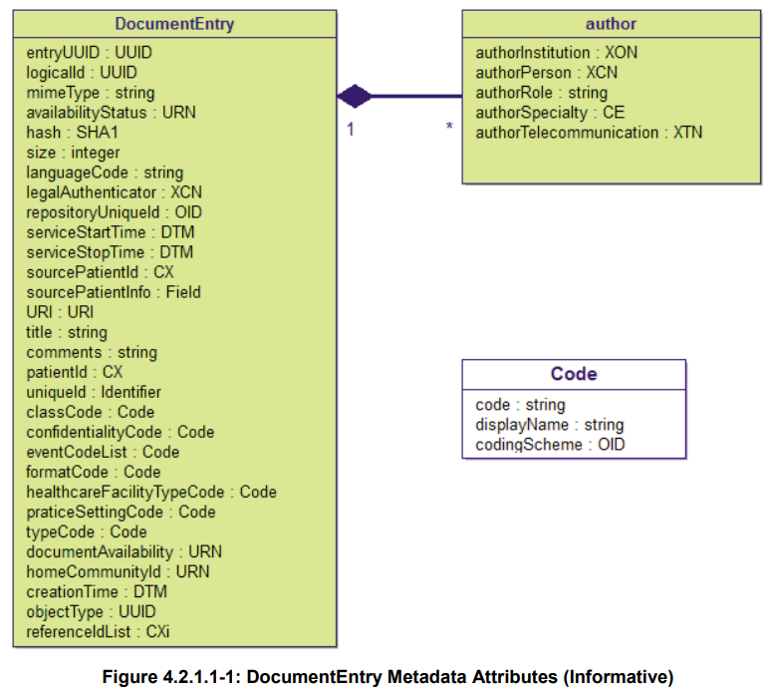
Metadata used in Document Sharing Profile DocumentEntry

Slide 37
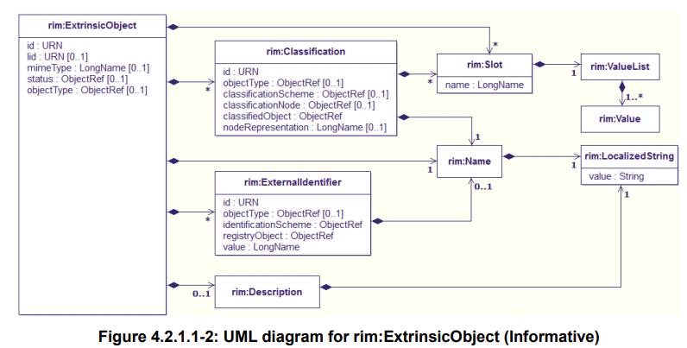
Metadata used in Document Sharing Profile DocumentEntry

Slide 38
On-Demand vs Stable Document Entry
A Stable Document Entry contain metadata about an already created document available for retrieval. Each Stable DocumentEntry represents a single document.
This document is stable because the contents have been effectively combined in the exact representation that will be returned in a Retrieve Document Set.
The uniqueID metadata attribute of a Stable DocumentEntry identifies the specific document associated with the entry. It is used in a retrieve request to identify which specific document should be retrieved.

Slide 39
On-Demand vs Stable Document Entry
An On-Demand Document Entry provides a unique identifier which can be used to create an on-demand document which collects the latest, most recent available information at the time of retrieval.
On-Demand Document Entries never reflect actual document content, but rather the potential for a document with the characteristics described in the metadata of the entry.
The uniqueID associated with an On-Demand Document Entry will never represent an actual document.
A retrieve request specifying an On-Demand Document Entry uniqueID will return content identified by a uniqueID different than the specified uniqueID.
Every On-Demand Document Entry with the same uniqueID will refer to the same potential content. Acrual content depends on the time of retrieval.
The On-Demand Document Entry uniqueID is valid for as long as the entry has availabilityStatus equal to Approved. The holder of the uniqueID may re-use it in a retrieve request to get the latest information, without the need for an additional query.
Ex. Patient status

Slide 40
On-Demand vs Stable Document Entry
An On-Demand Document Entry provides a unique identifier which can be used to create an on-demand document which collects the latest, most recent available information at the time of retrieval.
When a retrieve request is received specifying an On-Demand Document Entry uniqueID, the responder may choose to persist the document generated as a result and allow the requestor future access to metadata and document.

Slide 41
Metadata used in Document Sharing Profile SubmissionSet
DocumentEntry Metadata Attributes | Description | Patient identity | Provenance | Security &Privacy | Descriptive | Object Lifecycle | Exchange
author | The humans and/or machines that authored the SubmissionSet. This attribute contains the sub-attributes: authorInstitution, authorPerson, authorRole, authorSpecialty, authorTelecommunication. |  | ✓ | ✓ | ✓
availabilityStatus | The lifecycle status of the SubmissionSet. |  |  |  | ✓ | ✓
comments | Comments associated with the SubmissionSet. |  |  |  | ✓
contentTypeCode | The code specifying the type of clinical activity that resulted in placing the associated content in the SubmissionSet. |  | ✓ | ✓ | ✓
entryUUID | A globally unique identifier used to manage the entry. |  |  | ✓ | ✓ |  | ✓
homeCommunityId | A globally unique identifier for a community. |  |  |  |  |  | ✓
intendedRecipient | The organizations or persons for whom the SubmissionSet is intended. |  |  | ✓ |  |  | ✓
limitedMetadata | A flag that the associated SubmissionSet was created using the less rigorous metadata requirements as defined for the Metadata-Limited Document Source. |  | ✓ |  | ✓ | ✓ | ✓

Slide 42
Metadata used in Document Sharing Profile SubmissionSet
DocumentEntry Metadata Attributes | Description | Patient identity | Provenance | Security &Privacy | Descriptive | Object Lifecycle | Exchange
patientId | The patientId represents the primary subject of care of the SubmissionSet. | ✓ |  | ✓ | ✓
sourceId | Identifier of the entity that contributed the SubmissionSet. |  | ✓ | ✓ | ✓
submissionTime | Point in time at the creating entity when the SubmissionSet was created |  |  | ✓ | ✓ | ✓
title | The title of the SubmissionSet. |  |  |  | ✓
uniqueId | Globally unique identifier for the SubmissionSet assigned by the creating entity. |  |  | ✓ |  |  | ✓

Slide 43
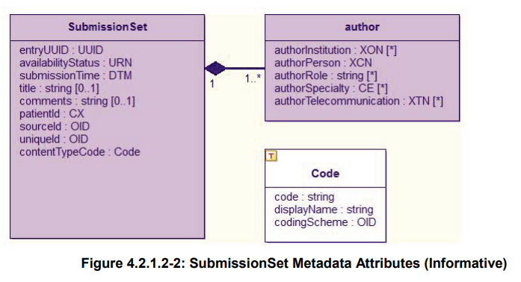
Metadata used in Document Sharing Profile SubmissionSet

Slide 44
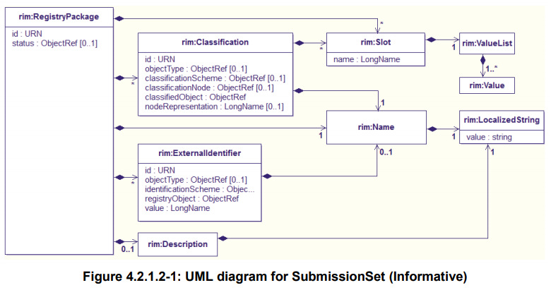
Metadata used in Document Sharing Profile SubmissionSet

Slide 45
Metadata used in Document Sharing Profile Folder
DocumentEntry Metadata Attributes | Description | Patient identity | Provenance | Security &Privacy | Descriptive | Object Lifecycle | Exchange
availabilityStatus | The lifecycle status of the Folder. |  |  | ✓ | ✓ | ✓
codeList | The set of codes specifying the type of clinical activities that resulted in placing DocumentEntry objects in the Folder. |  | ✓ | ✓ | ✓
comments | Comments associated with the Folder. |  |  |  | ✓
entryUUID | A globally unique identifier used to manage the entry. |  |  | ✓ | ✓ |  | ✓
homeCommunityId | A globally unique identifier for a community. |  |  |  |  |  | ✓
lastUpdateTime | Most recent point in time that the Folder has been modified. |  |  | ✓ |  | ✓
limitedMetadata | A flag that the associated Folder was created using the less rigorous metadata requirements as defined for the Metadata-Limited Document Source. |  | ✓ |  | ✓ | ✓ | ✓
patientId | The patientId represents the primary subject of care of the Folder. | ✓ |  | ✓ | ✓
title | The title of the Folder |  |  |  | ✓
uniqueId | Globally unique identifier for the Folder. |  |  | ✓ |  |  | ✓

Slide 46
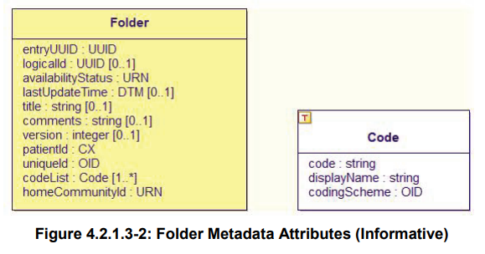
Metadata used in Document Sharing Profile Folder

Slide 47
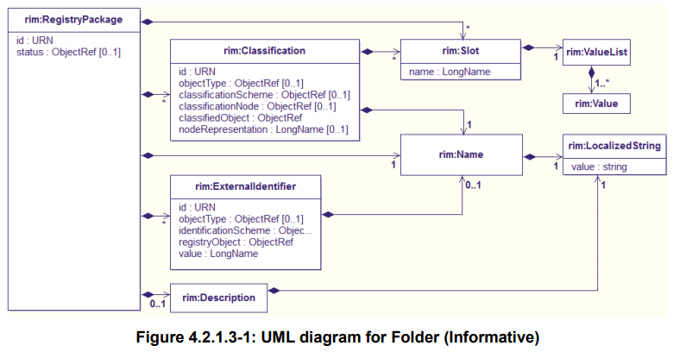
Metadata used in Document Sharing Profile Folder

Slide 48
Metadata used in Document Sharing Profile
Which metadata attributes an actor shall provide when initiating a Submission Type Transaction.
Code | Meaning
R | Required – A value for the attribute shall be supplied by the sending actor when sending the submission
R2 | Required if Known – A value for the attribute shall be supplied by the sending actor when sending the submission unless the actor does not have any value for the attribute
O | Optional – The sending actor may or may not supply a value for this attribute
X | Prohibited – when sending a submission, a value for the attribute shall not be supplied by the sending actor.

Slide 49
Metadata used in Document Sharing Profile
Which metadata attributes an actor shall provide when initiating a Submission Type Transaction.
Actor | Transaction | Shortname
XDS Document Source | Provide and Register Document Set-b [ITI-41] | XDS DS
XDS Document Repository | Register Document Set-b [ITI-42] | XDS DR
XDS On-Demand Document Source | Register On-Demand Document Entry [ITI-61] | XDS OD

Slide 50
Metadata used in Document Sharing Profile
Metadata Element | Metadata Attribute | XDS DS | XDS DR | XDS OD
DocumentEntry | author | R2 | R2 | R2
DocumentEntry | availabilityStatus | O | O | O
DocumentEntry | classCode | R | R | R
DocumentEntry | comments | O | O | O
DocumentEntry | confidentialityCode | R | R | R
DocumentEntry | creationTime | R | R | X
DocumentEntry | entryUUID | R | R | R
DocumentEntry | eventCodeList | O | O | O
DocumentEntry | formatCode | R | R | R
DocumentEntry | hash | O | R | X

Slide 51
Metadata used in Document Sharing Profile
Metadata Element | Metadata Attribute | XDS DS | XDS DR | XDS OD
DocumentEntry | healthcareFacilityTypeCode | R | R | R
DocumentEntry | homeCommunityId | O | O | O
DocumentEntry | languageCode | R | R | R
DocumentEntry | legalAuthenticator | O | O | O
DocumentEntry | limitedMetadata | X | X | X
DocumentEntry | mimeType | R | R | R
DocumentEntry | objectType | R | R | R
DocumentEntry | patientId | R | R | R
DocumentEntry | practiceSettingCode | R | R | R
DocumentEntry | referenceIdList | O | O | O

Slide 52
Metadata used in Document Sharing Profile
Metadata Element | Metadata Attribute | XDS DS | XDS DR | XDS OD
DocumentEntry | repositoryUniqueId | O | R | R
DocumentEntry | serviceStartTime | R2 | R2 | O
DocumentEntry | serviceStopTime | R2 | R2 | O
DocumentEntry | size | O | R | X
DocumentEntry | sourcePatientId | R | R | R
DocumentEntry | sourcePatientInfo | O | O | O
DocumentEntry | title | O | O | O
DocumentEntry | typeCode | R | R | R
DocumentEntry | uniqueId | R | R | R
DocumentEntry | URI | O | O | O

Slide 53
Metadata used in Document Sharing Profile
Metadata Element | Metadata Attribute | XDS DS | XDS DR | XDS OD
SubmissionSet | author | R2 | R2 | R2
SubmissionSet | availabilityStatus | O | O | O
SubmissionSet | comments | O | O | O
SubmissionSet | contentTypeCode | R | R | R
SubmissionSet | entryUUID | R | R | R
SubmissionSet | homeCommunityId | O | O | O
SubmissionSet | intendedRecipient | O | O | O
SubmissionSet | limitedMetadata | X | X | X
SubmissionSet | patientId | R | R | R
SubmissionSet | sourceId | R | R | R

Slide 54
Metadata used in Document Sharing Profile
Metadata Element | Metadata Attribute | XDS DS | XDS DR | XDS OD
SubmissionSet | submissionTime | R | R | R
SubmissionSet | title | O | O | O
SubmissionSet | uniqueId | R | R | R
Folder | availabilityStatus | O | O | O
Folder | codeList | R | R | R
Folder | comments | O | O | O
Folder | entryUUID | R | R | R
Folder | homeCommunityId | O | O | O
Folder | lastUpdateTime | O | O | O
Folder | limitedMetadata | X | X | X

Slide 55
Metadata used in Document Sharing Profile
Metadata Element | Metadata Attribute | XDS DS | XDS DR | XDS OD
Folder | patientId | R | R | R
Folder | title | R | R | R
Folder | uniqueId | R | R | R

Slide 56
Metadata used in Document Sharing Profile
Which metadata attributes shall contain content in a response to a query transaction.
Actor | Transaction | Shortname
XDS Document Registry | Registry Stored Query [ITI-18] | XDS DR

Slide 57
Metadata used in Document Sharing Profile
Which metadata attributes shall contain content in a response to a query transaction.
Code | Meaning
R | Required – A value for the attribute shall be supplied by the responding actor when responding to a query
R2 | Required if Known – A value for the attribute shall be supplied by the responding actor when responding to the query if a value is available to the actor. For the Document Registry it must supply the value specified in the submission request.
O | Optional – The responding actor may or may not supply a value for this attribute. For the Document Registry it must supply the value specified in the submission request.
X | Prohibited – when responding to a query, a value for the attribute shall not be supplied by the responding actor.
R3 | Required for Stable DocumentEntries and not allowed for On-Demand DocumentEntries.

Slide 58
Metadata used in Document Sharing Profile
Metadata Element | Metadata Attribute | XDS DR
DocumentEntry | author | R2
DocumentEntry | availabilityStatus | R
DocumentEntry | classCode | R
DocumentEntry | comments | O
DocumentEntry | confidentialityCode | R
DocumentEntry | creationTime | R3
DocumentEntry | entryUUID | R
DocumentEntry | eventCodeList | O
DocumentEntry | formatCode | R
DocumentEntry | hash | R3

Slide 59
Metadata used in Document Sharing Profile
Metadata Element | Metadata Attribute | XDS DR
DocumentEntry | healthcareFacilityTypeCode | R
DocumentEntry | homeCommunityId | O
DocumentEntry | languageCode | R
DocumentEntry | legalAuthenticator | O
DocumentEntry | limitedMetadata | X
DocumentEntry | mimeType | R
DocumentEntry | objectType | R
DocumentEntry | patientId | R
DocumentEntry | practiceSettingCode | R
DocumentEntry | referenceIdList | O

Slide 60
Metadata used in Document Sharing Profile
Metadata Element | Metadata Attribute | XDS DR
DocumentEntry | repositoryUniqueId | R
DocumentEntry | serviceStartTime | R2
DocumentEntry | serviceStopTime | R2
DocumentEntry | size | R3
DocumentEntry | sourcePatientId | R
DocumentEntry | sourcePatientInfo | O
DocumentEntry | title | O
DocumentEntry | typeCode | R
DocumentEntry | uniqueId | R
DocumentEntry | URI | O

Slide 61
Metadata used in Document Sharing Profile
Metadata Element | Metadata Attribute | XDS DR
SubmissionSet | author | R2
SubmissionSet | availabilityStatus | R
SubmissionSet | comments | O
SubmissionSet | contentTypeCode | R
SubmissionSet | entryUUID | R
SubmissionSet | homeCommunityId | O
SubmissionSet | intendedRecipient | O
SubmissionSet | limitedMetadata | X
SubmissionSet | patientId | R
SubmissionSet | sourceId | R

Slide 62
Metadata used in Document Sharing Profile
Metadata Element | Metadata Attribute | XDS DR
SubmissionSet | submissionTime | R
SubmissionSet | title | O
SubmissionSet | uniqueId | R
Folder | availabilityStatus | R
Folder | codeList | R
Folder | comments | O
Folder | entryUUID | R
Folder | homeCommunityId | O
Folder | lastUpdateTime | O
Folder | limitedMetadata | X

Slide 63
Metadata used in Document Sharing Profile
Metadata Element | Metadata Attribute | XDS DR
Folder | patientId | R
Folder | title | R
Folder | uniqueId | R

Slide 64
Which attributes need encrypt?
sourcePatientInfo
This attribute contains demographic information of the source patient to whose medical record this document belongs.
Coded as an ebRIM Slot. If present, each rim: Value contains a Field. Multiple rim:Value elements may exist for the same field name as a way to implement repetition; there shall be at most one rim: Value element for each of the PID-7 and PID-8 fields. Only field defined for the PID segment shall be used.
Maximum length of each rim: Value is 256 characters. The sourcePatientInfo attribute should include:
PID-3 (source patient identifier list)
PID-5 (source patient name)
If multiple patient names are present, then PID-5.7 “Name Type Code” and PID-5.8 “Name Representation Code” should be valued in each entry.
PID-7 (source patient date of birth)
PID-8 (source patient gender)
*The sourcePatientInfo attribute should not include values for PID-2 (patient id), PID-4 (alternate patient id), PID-12 (country code), or PID-19 (social security number).

Slide 65
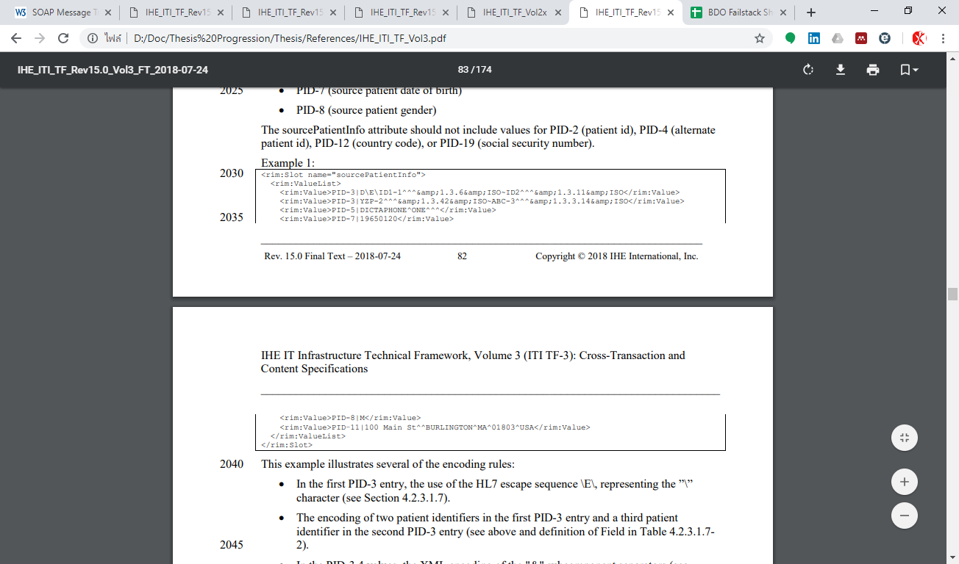
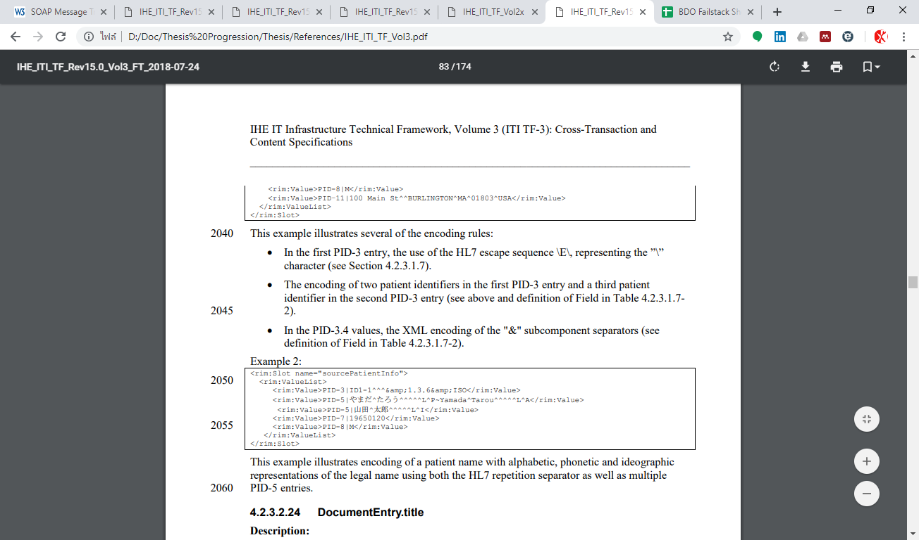
Which attributes need encrypt?

Slide 66
Which attributes need encrypt?

Slide 67
Cross-Enterprise Document Sharing – b (XDS.b)
Notes:
There should be some kind of header that specify type of transaction

Slide 68
Design Analysis Component – Document Registry actor and Document Consumer as Blockchain node
Replace software/server of Document Registry and Document Consumer actor with Blockchain Node
How to
Use Web3js Javascript programming module to interface other components to interact with Blockchain Node
Each members of XDS Affinity Domain will need to host at least one of these Blockchain Node
Each Blockchain node will require user authentication to access, i.e. Password, to help tracking about user’s identity for security purpose
This passively integrate Document Registry actor and Document Consumer actor together, for each member of XDS Affinity Domain
Syncing between Document Registry actor of each XDS Affinity Domain members will rely on networking protocol of the selected Blockchain platform
For Ethereum, it is ÐΞVp2p Wire Protocol
Behind the design
Avoid modifying of Document Repository actor
Document Registry actor is the main actor that have the role to maintain registry entry
Always need accessibility to the Blockchain ledger
Need passive sync between each copies of document registry entry
Audit trail of activity interacting with the Blockchain ledger and user’s identity

Slide 69
Cross-Enterprise Document Sharing – b (XDS.b)
Notes:
There should be some kind of header that specify type of transaction

Slide 70
Design Analysis Component – Document Registering
Convert received [ITI-42] transaction to Document Register contract and publish on Blockchain
Existing
Document Registry actor parse ITI-42 transaction and store the registry into its database
Requirement
Compatible to operate with Ethereum Blockchain
Publish Document Registry into Blockchain
Allow additional mechanism for Smartcontract
Search index function that response to registry query application
Return XML message function that response to Registry Query [ITI-18] transaction issued from Document Consumer actor
Any XDS transaction attribute that have potential to exposing patient Protected Health Information as identified by HIPAA, must be encrypted
How to
Add Document Register contract publisher function which will use programming object received from [ITI-42] transaction to issue Smartcontract
Add Smartcontract function
Search index function
Return XML message function
*Both contracts will have its attributes following its parent [ITI-42] transaction
Encrypt ‘sourcePatientInfo’ attribute as it potentially expose patient protected health information

Slide 71
Cross-Enterprise Document Sharing – b (XDS.b)
Notes:
There should be some kind of header that specify type of transaction

Slide 72
Design Analysis Component – Discovering document registry entry
Replacing database query with Blockchain search application as response Registry Query
Existing
Document Consumer actor seek for metadata of document by send Registry Query [ITI-18] with specified index of target document, to Document Registry
Document Registry response to the transaction and use specified index to query for target document metadata within its database
Document Registry return metadata of target document to Document Consumer actor
Requirement:
Capable to search for target document metadata using specified index (attributes) within Blockchain (Registry entry)
Publish registry query request to Blockchain as additional audit trail
How to
Document Consumer actor publish Registry Query Contract to Blockchain and send contract address to Document Registry actor
After received and verified Registry Contract from Document Consumer actor, Document Registry start search for matching document metadata
Document Registry actor will have application that take the role to accept the index and sequentially search for contract of matching document metadata
Each document metadata have Smartcontract function that ready to response to matching specified index
Search application also remember contract address of searched document metadata, to allow faster search if there are query for the same document metadata
Document Registry actor return XML message of contract with matching document metadata to Document Consumer actor

Slide 73
Design Analysis Component – Discovering document registry entry
Related work
Ethereum Query Language
Bragagnolo S, Rocha H, Denker M, Ducasse S. Ethereum query language. 2018 IEEE/ACM 1st Int Work Emerg Trends Softw Eng Blockchain. ACM; 2018;1–8.
There are 2 ways of discover transactions within Ethereum Blockchain, which are, sequentially search all transaction one by one and discover transaction using its unique address
We can adopt sequential search method for first time search
Then use off-chain application to remember contract eth address for faster access on next time.
Query Support for Data Processing and Analysis on Ethereum Blockchain
Pratama FA, Mutijarsa K. Query Support for Data Processing and Analysis on Ethereum Blockchain. 2019;1–5.
With current state of Blockchain technology, it may need off-chain storage to effectively handle stuff from Blockchain instead of Smartcontract itself.
Analytical Tools for Blockchain: Review, Taxonomy and Open Challenges
Balaskas A, Franqueira VNL. Analytical Tools for Blockchain: Review, Taxonomy and Open Challenges. 2018 Int Conf Cyber Secur Prot Digit Serv Cyber Secur 2018. IEEE; 2018;1–8.
There are various kind of community-made tools that provide Blockchain transaction search function, available

Slide 74
Cross-Enterprise Document Sharing – b (XDS.b)
Notes:
There should be some kind of header that specify type of transaction

Slide 75
Design Analysis Component – Document retrieval audit trail
Replace Document Retrieval [ITI-43] transaction with Smartcontract
Existing
After Document Consumer actor obtained information about Document Repository actor from Document Registry actor, Document Consumer actor issue Document Retrieval [ITI-43] transaction to Document Repository actor.
Document Repository actor response to the transaction and send the requested document back to Document Consumer actor.
Requirement
Following format of Document Retrieval [ITI-43] transaction
Record the action to Blockchain as additional audit trail
How to
Document Consumer publish Document Retrieval contract to Blockchain and send contract address to Document Repository actor
Document Repository actor received and verified Document Retrieval contract and response to Document Consumer actor with the requested document

Slide 76
Design
From perspective of Blockchain component
Consensus
Etc.
Each block will have?
If have encryption, what kind of technic/infrastructure will be used
Flow chart of all process
Allow add idea about authentication and encryption
Better explanation on replacing actor with Blockchain node

Slide 77
Transaction
มีแบบตอบกลับ consumer แบบเลือก attribute มั้ย (all or nothing หรือ selective)
ใน transaction มี option ให้ขอแค่บางส่วนหรือเปล่า

Slide 78
Blockchain component Blockchain types
Blockchain Types
Public Blockchain:
It is accessible to all the people in a public area.
Everyone can become one of the nodes and make contributions to obtain the rewards following the rules.
There are no trust relationships among the nodes.
Public Blockchain is completely open and decentralized.
All transactions on the public Blockchain can never be changed or revoked.
Private Blockchain:
The owner of the Blockchain has the highest authority to change the information.
The rest of the nodes have limited access to read.
Compared to the public Blockchain, the private Blockchain has the characteristics of easy modification and low transaction cost.
Transaction verification of the private Blockchain only need some designated high credit nodes.
Private Blockchain is applied to more closed networks such as the intranet.
It is more important to solve the crash faults than Byzantine faults.

Slide 79
Blockchain component Blockchain types
Blockchain Types
Permissioned Blockchain (aka Consortium Blockchain):
The Blockchain is composed of many parties and the main nodes are pre-specified by the participants.
The members of the Blockchain do not fully trust the others.
Each participant selects its own consensus node according to the rules.
Transactions need to be recognized by most consensus nodes.

Slide 80
Blockchain component Blockchain types
Considering our scenario
The Blockchain is composed of many hospitals and the main nodes are pre-specified by the XDS Affinity Domain members.
The members of the Blockchain do not fully trust the others. This also included the case that node got compromised by cyber-criminal.
Each participant selects its own consensus node according to the rules.
Transactions related to XDS Document Registry need to be recognized by most consensus nodes.
XDS Affinity Domain Blockchain is Permissioned Blockchain (aka Consortium Blockchain)

Slide 81
Blockchain component Consensus
There are various types of consensus invented by Blockchain community to meet some specific use cases.
Main Consensus Types
Proof of Work (PoW)
Proof of Stakes (PoS)
Delegated Proof of Stake (DPoS)
Practical Byzantine Fault Tolerance (PBFT)
Raft
Proof of Authority (PoA)
*It must be noted that consensus are created to prevent modification of data during transition before published to the Blockchain (while initial data are being transmit to all nodes). If initial data was tampered or modified from the start, consensus cannot help that.

Slide 82
Blockchain component Consensus
Proof of Work (PoW)
Its core idea is to allocate the accounting rights and rewards through the hashing power competition among the nodes.
Based on the information of the previous block, the different nodes calculate the specific solution of a mathematical problem. The first node that solves this math problem can create the next block and get a certain amount of reward.
In Bitcoin, Satoshi Nakamoto used HashCash to design this mathematics problem.
PoW takes the workload as the safeguard.
The newly created block is linked to the blocks in front of it. The length of the chain is proportional to the amount of workload. All nodes trust the longest chain.
If anyone wants to tamper with the Blockchain, he needs to control more than 50% of the world’s hashing power to ensure that he can become the first one to generate the latest block and master the longest chain.
The gains from tampering can be much greater than the cost. So the PoW can effectively guarantee the safety of the Blockchain
However, PoW have limitation that it waste high amount of resources, give low transaction throughput rate and slow speed of transactions.
PoW also affected by the concentration of hashing power where more than one organization join together to form “mining pool” which potentially have a monopoly of accounting if they gain hashing power more than 50% of global hashing power.
PoW can tolerate malicious nodes up to 50% of all nodes

Slide 83
Blockchain component Consensus
Proof of Stake (PoS)
In PoS, the digital currency has the concept of ‘coin age’.
Coin age of a coin is its value multiplied by the time period after it was created. The longer one node holds the coins, the more rights it can get in the network.
Holders of the coins will also receive a certain reward according to the coin age.
PoS limits the hashing power of each node. The difficulty of mining is inversely proportional to coin age.
PoS encourages the coins holders to increase the holding time.
With the concept of coin age, the Blockchain is no longer entirely relying on the proof of work. That effectively solves the resource wasting problem in PoW.
The security of the Blockchain using PoS improves with the increasing value in the Blockchain. The attackers need to accumulate a large number of coins and hold them long enough to attack the Blockchain. This also greatly increases the difficulty of attack.
PoS have similar outcome when compared to PoW
The coin age concept also destroyed in usual transactions, which may make participants more interested in collecting the coins instead of using them.

Slide 84
Blockchain component Consensus
Delegated Proof of Stake (DPoS)
In the Blockchain with DPoS, each node can select the witnesses based on its stake.
In the whole network, the top N witnesses that have participated in the campaign and got the most votes have the accounting right.
The number N of witnesses is defined such that at least 50% of voting stakeholders believe there is sufficient decentralization.
The elected witnesses create new blocks one by one as assigned and get some rewards. The witnesses need to ensure adequate online time. If a witness is unable to create its assigned block, the activity of that block will moved to the next block and the stakeholders will vote for a new witness to replace it.
The Blockchain using DPoS is more efficient and power-saving than PoW
DPoS reduce the problem that participant more interested in collecting the coins instead of using them.
The scalability is unlimited.

Slide 85
Blockchain component Consensus
Practical Byzantine Fault Tolerance (PBFT)
In distributed systems, Byzantine Fault Tolerance can be a good method to solve the transmission errors. But early Byzantine system requires exponential operations. Until 1999, the PBFT (Practical Byzantine Fault Tolerance) system was proposed and the algorithm complexity was reduced to a polynomial level, which greatly improved efficiency.
The consensus assume that faulty nodes are minority of the network and rely on ‘good node’ which are majority of the network to settle the consensus
3-phase consensus
The network with PBFT must consists of 3f+1 server nodes where f represent faulty nodes.
The client sends a request to the master server node. The master server node gives the request a timestamp, then records the request message and gives it an order number. After that, the master node broadcasts a pre-prepare message (the request) to the other following nodes.
Each node determine whether to accept the request or not. If choose to accept, it broadcasts a prepare message to all the other server nodes and receives the prepare message from the other nodes.
After having collect 2f+1 messages, if a majority of nodes choose to accept the request, then it will enter the commit state.
Each node in commit state sends a commit message to all other nodes to announce that it commit the request. If a server node receives 2f+1 commit messages, it could believe that most nodes reach a consensus to accept the request. The server nodes then reply to the client.
There is a variant of PBFT that tweaked for suitable with Ethereum Blockchain environment called ‘Istanbul Byzantine Fault Tolerance’ or IBFT.

Slide 86
Blockchain component Consensus
Practical Byzantine Fault Tolerance (PBFT)
PBFT can tolerate at most 33% of malicious nodes sum up with crash fault nodes
As the nodes in PBFT need to communicate with every node to reach the agreement, the scalability is limited.
In the Blockchain with PBFT, the verification functions are done in the server. One server node needs to communicate with all the other nodes. The data processing size and time consumption are huge. As the size of the network increase, the efficiency of consensus will drastically decrease. This limit scalability of PBFT Blockchain.
PBFT is more suitable for the permissioned Blockchain system with high-speed network and a small number of nodes.

Slide 87
Blockchain component Consensus
Istanbul Byzantine Fault Tolerance (IBFT)
Improvement compare to the original PBFT
In Blockchain environment, there is no specific “client” which sends out requests and waits for the results. Instead, all of the validators can be seen as clients.
To keep the Blockchain progressing, a proposer will be continuously selected in each round to create block proposal for consensus.
For each consensus result, the development team expect to generate a verifiable new block rather than a bunch of read/write operations to the file system.
IBFT inherits from the original PBFT by using 3-phase consensus
Before each round, the validators will pick one of them as the proposer, by default, in a round robin fashion.
The proposer will then propose a new block proposal and broadcast it along with the PRE-PREPARE message.
Upon receiving the PRE-PREPARE message from the proposer, validators enter the state of PRE-PREPARED and then broadcast PREPARE message. This step is to make sure all validators are working on the same sequence and the same round.
While receiving 2F + 1 of PREPARE messages, the validator enters the state of PREPARED and then broadcasts COMMIT message. This step is to inform its peers that it accepts the proposed block and is going to insert the block to the chain.
Lastly, validators wait for 2F + 1 of COMMIT messages to enter COMMITTED state and then insert the block to the chain.

Slide 88
Blockchain component Consensus
Raft
Raft is a consensus algorithm developed by researchers at Stanford University.
Main goal of this consensus algorithm is to provide Crash Fault Tolerant (CFT)
As opposed to Byzantine Fault Tolerance, in Raft the leader is assumed to always act correctly (honestly)
All the followers blindly replicate the entries proposed by the leader with no questions asked.
If the leader crashes, the remainder of the network will automatically elect a new leader after a set period of timeout, and the network will continue to function.
When the crashed node recovers, it will become a follower and start replicating the blocks it has missed while offline.
Raft provide very high efficiency and simplicity on transaction processing
Raft cannot tolerate malicious nodes and can tolerate up to 50% nodes of crash fault. That mean, it is important to guarantee the absolute security of the leader node and throughput is limited by the maximum performance of one node.
The scalability is limited by the architecture of RAFT

Slide 89
Blockchain component Consensus
Proof of Authority
PoA algorithms rely on a set of N trusted nodes called the authorities. Each authority is identified by a unique id and a majority of them is assumed honest, namely at least N=2 + 1.
The authorities run a consensus to order the transactions issued by clients.
Consensus in PoA algorithms relies on a mining rotation schema, a widely used approach to fairly distribute the responsibility of block creation among authorities. Time is divided into steps, each of which has an authority elected as mining leader.
There are 2 implementation clients in Ethereum, which are Aura and Clique
PoA prioritize availability over consistency of data, or ‘AP’ following CAP theorem.
The CAP theorem states that in a distributed data store only two out of the three following properties can be ensured: Consistency (C), Availability (A), and Partition Tolerance (P)
PBFT can be categorized as CP
This mean, when compared to PBFT, PoA provide guarantee that its simpler model allow more success rate for publishing submitted transaction to Blockchain. However, PoA sacrifice consistency where “fork” of the Blockchain can occur.
Forked chain can potentially cause conflict of data. It will require more process to judge which fork will be continued as the main chain and how to handle data different in forked chain. This increase difficulty in Blockchain usage and implementation.

Slide 90
Blockchain component Consensus
Characteristics | Consensus Alogorithms
 | PoW | PoS | DPoS | PBFT | RAFT
Byzantine Fault Tolerance (% malicious node) | 50% | 50% | 50% | 33% | -
Crash Fault Tolerance (%nodes of crash fault) | 50% | 50% | 50% | 33% | 50%
Verification speed (time) | >100s | <100s | <100s | <10s | <10s
Throughput (Transaction Per Second) | <100 | <1000 | <1000 | <2000 | >10k
Scalability | Almost unlimited | Almost unlimited | Unlimited | Small number of nodes | Limited by architecture

Slide 91
Blockchain component Consensus
References
A Review on Consensus Algorithm of Blockchain
D. Mingxiao, M. Xiaofeng, Z. Zhe, W. Xiangwei and C. Qijun, "A review on consensus algorithm of blockchain," 2017 IEEE International Conference on Systems, Man, and Cybernetics (SMC), Banff, AB, 2017, pp. 2567-2572.
Main references for Consensus types and Blockchain types
Analysis on suitability between each Blockchain types and Consensus
PBFT vs Proof-of-Authority: Applying the CAP Theorem to Permissioned Blockchain
De Angelis S, Aniello L, Baldoni R, Lombardi F, Margheri A, Sassone V. PBFT vs proof-of-authority: Applying the CAP theorem to permissioned blockchain. CEUR Workshop Proc. 2018;2058:1–11.
Main references for Proof of Authority
Analysis on PBFT vs Proof of Authority and its suitable use cases.
Istanbul Byzantine Fault Tolerance
yutelin. Istanbul Byzantine Fault Tolerance [Internet]. [cited 2019 Apr 9]. Available from: https://github.com/ethereum/EIPs/issues/650
Main references for Istanbul Byzantine Fault Tolerance
Consensus Algorithms: PoA, IBFT or Raft?
Jim Zhang. Consensus Algorithms: PoA, IBFT or Raft? - Kaleido - Kaleido [Internet]. 2018 [cited 2019 Apr 9]. Available from: https://kaleido.io/consensus-algorithms-poa-ibft-or-raft/
Characteristics and different between PoA, IBFT, and Raft

Slide 92
Blockchain component Consensus
Considering our scenario
XDS Affinity Domain Blockchain is Permissioned Blockchain.
Each hospitals participate in XDS Affinity Domain will be represent by at least one Blockchain node
XDS Affinity Domain would not be able to effort Proof of Work consensus as it waste computational resources
Priority integrity of Document Registry entry followed by its Availability and Confidentiality.
In this work, XDS Affinity Domain Blockchain will have less than 30 member nodes participated. That mean decreased in efficiency problem due to large amount of consensus node is not a major issue.
Blockchain transaction are mainly use for sharing ‘Stable Document Entry’ and record some activity for system audit. Which mean transaction processing speed is not a major issue like it does in cryptocurrency. However, it still require enough efficiency to operate with continuous medical operation.
PBFT is the most suitable consensus for the scenario.
Suitable with Permissioned Blockchain with less than 30 consensus nodes
Priority consistency of data entering the Blockchain
Require lesser computational resource when compared to Proof of Work

Slide 93
Hospital A
Document Registry
Hospital B
Hospital B
Document Registry
Document Registry
Hospital C
Document Registry
XDS Blockchain Network

